Slide 2
Agenda
Introductions
Outcome / Objective
What is the Significance
What can be done to Protect
Recruiting
Pre-Interviewing
Interviewing
First Day
First 90 Days (Probationary Period)

Slide 3
Introductions Your Speakers
Jon Birkes, MS, CSP – Site SHE Manager, Henkel Adhesive Technologies. Jon has worked as a safety professional for a little over 11 years. At Case Western Reserve University, Jon was involved in physical/chemical/biological safety as well as managed the campus DOT shipping program and laboratory decommissioning. While at JLL, at the Lubrizol Corporation, Jon gained expertise in process safety, facility safety, and construction safety. Jon is now working at the Henkel Corporation, at a manufacturing facility in the Cleveland area.
Tobin Hawes – Regional SHE Manager, Henkel Adhesive Technologies. Tobin has been a SHE Manager with Henkel since 2014. Previously, Tobin was a Site Safety Manager for Graphic Packaging and The Corporate EHS Manager for Easton-Bell Sports. Over the last 29 years Tobin has held roles in Product and Fixture Design, Process Engineering, Facility Engineering, and Maintenance Management. Tobin has worked in the Metal Cutting Industry, Medical Device Industry, Plastic and Paperboard Packaging and Chemical Manufacturing Industries.

Slide 4
Outcomes / Objectives What are you going to get out of today
Some things to consider…
Before,
During
and After, the hiring / onboarding process
Including…
Training
Common Sense
Mentoring
and Effectiveness Checks

Slide 5
What is the Significance Stats on Injuries
According to OSHA and the BLS;
335 young workers were killed in 2013.
Workers <25 years old are twice as likely to end up in the ER than workers >25.
Every 9 minutes a US teen gets hurt on the job.
45 minutes of training = 5 young workers hurt.
WHY?

Slide 6
What is the Significance True Stories
PhD Student (approx. 21) – Working toward their PhD in Chemistry.
Employee (approx. 18) – Using a “parts washer” at a manufacturing facility. 1st day on the job.
Temporary Employee (approx. 22) – Operating a forklift in a warehouse.

Slide 7
What Can Be Done? Recruiting
Goal: Get the right candidates to interview for the role
Define what the skill level is for the job
What are the expectations of the job?
What type of work will the person be doing?
Consider what type of hazards / risks they may be exposed
What will be the safety responsibilities of the job

Slide 8
What Can Be Done? Pre-Interviewing
Goal: Should you test for a skill level or knowledge?
English comprehension?
Understanding verbal / Written Instructions
Math?
Mechanical aptitude?
What are the show stoppers that would immediately eliminate a person?
STICK TO YOUR STANDARDS!

Slide 9
What Can Be Done? Interviewing
Goal: What Safety related questions do you ask?
General:
Tell me about a time you had to follow a specific safety protocol in your jobs.
Tell me about a time you felt unsafe at work and how did you resolve the issue?
Ask them if they have safety concerns about working in your industry.

Slide 10
What Can Be Done? Interviewing
Goal: What Safety related questions do you ask?
Develop specific questions surrounding your industry.
What do you know about LOTO
Have you ever worked around machinery (cars, wood shop, etc)
Have you worked on a ladder around your house?
Have you ever used hand tools. What type of safety practices do you use?

Slide 11
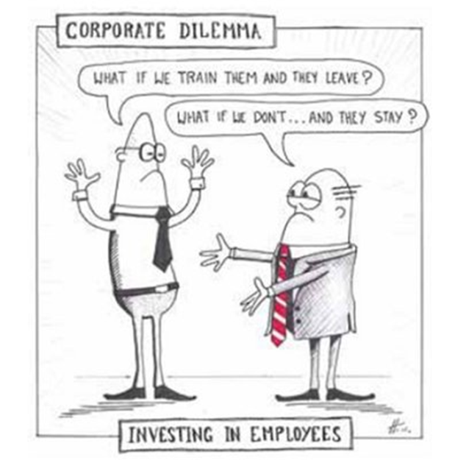
Training How to Train
Just as important as what to train is how to go about it.
What is you Objective when you train?
Check a box to ensure compliance
Or, do you want…
To facilitate Learning
Develop Skills
Increase Understanding
Increase Performance and Productivity

Slide 12
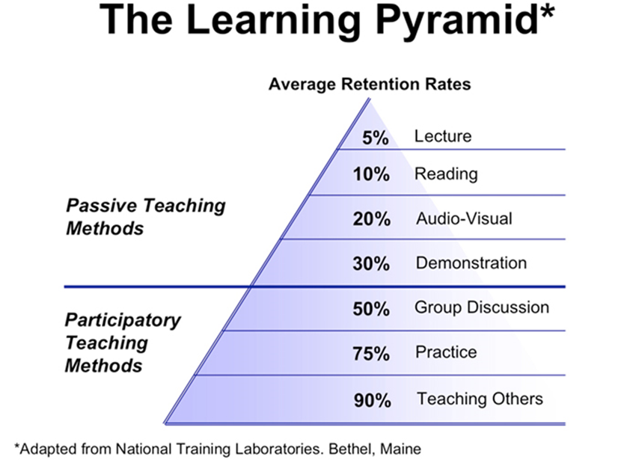
Training How to Train

Slide 13
First Day What to train new hires on
HazCom
Bloodborne Pathogens
Emergency Response
Site Specific Hazards
Right to Refuse
Working Safely is a Condition of Employment

Slide 14
First Day Never, Never, Never Assume
Assuming that a person will have “common sense” will ensure that you are going to have an injury.

Slide 15
First Day Mentoring / Safety Buddy
Is there someone that can help train the person that you know will show them the right way, not the shortcut
Provide them someone they can feel safe asking questions
People will naturally say they understand, when they don’t.
Young workers are aiming to please.

Slide 16
Day 1 to 90 Days Probationary Period
Be sure that you are following up with the employee/your normal review process.
If there are safety concerns, make sure the employee is aware.
Is the person safety-minded or a risk.
If you feel there is a risk to their safety, terminate.

Slide 17
Resources
https://www.osha.gov/youngworkers/resources.html
SafeMe App – Grant provided by Washington State Department of Labor & Industries
Addresses the need for entry level workers to have “better basic safety training to join the workforce”.
ASSE Young Worker Brochure (On the Tables)
NIOSH Talk Safety Tips: https://www.cdc.gov/niosh/talkingsafety/states/oh/2015-152/default.html
Safety Matters Presentation

Slide 18
Thank you!

